Slide 1
Routing Protocols: An Overview
Sankhayan Choudhury

Slide 2
Routing: Overview
Routing is the most crucial design issue in layer 3.
Routing is the process of establishing the routes (Via intermediate nodes) that data packets must follow to reach the destination.
Each node must contain a routing table that holds the path to reach all possible destinations with the assigned cost.
In a simplest form, the attributes could be Destination, Next hop and the cost for reaching the destination. The following could be the routing table of a node A.
Destination | Next Hop | Cost (in hops)
A | - | -
B | C | 5
D | B | 4

Slide 3
Routing: Classification
Static: Contents of the routing table is fixed and entered manually
Adaptive: The routing decision changes with the
Changes in topology
Changes in traffic density
Adaptive routing (s)
Isolated : Table changes based on the information available in a specific node
Centralized: Routing Control centre (RCC); all nodes gather information and send to RCC; RCC computes the decision on behalf of all the nodes and transmit the routing table
Distributed: All nodes are exchanging information with the neighbouring nodes (Nodes those are one-hop away) and updates the table accordingly

Slide 4
Flooding: A simplest example of Routing
Flooding is a simplest example of routing. (Broadcasting)
This adapts the technique in which every incoming packet is sent on every outgoing line except from which it arrived. One problem with this is that packets may go in loop and as a result, a node may receive duplicate packets.
This duplication wastes huge bandwidth, the most costly resource in the network.
The strength is simplicity; and the nodes are receiving the packets using best path, second best path and so on. Reliability is increased.

Slide 5
Flooding
Duplications.....Major problem
Solution:
One such measure is to have a hop counter contained in the header of each packet that is decremented at each hop, The packet is discarded when the counter reaches zero.
Ideally, the hop counter could be initialized by the full diameter of the network i.e. the worst-case.

Slide 6
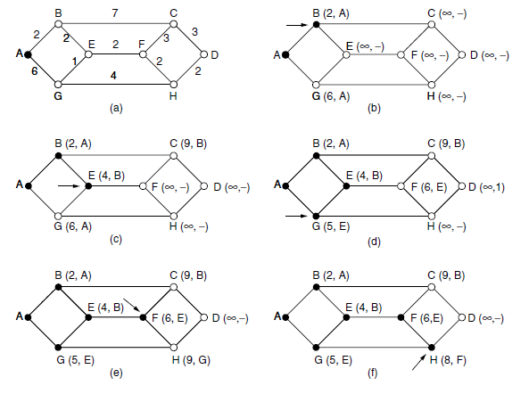
Unicast Routing
A network can be modelled by a Graph; Minimum Spanning Tree of a graph is a sub-graph having all the vertices and those vertices are connected by a route having minimum cost. One of the these algos is Dijkstra algorithm and can be used as a unicast routing algorithm.

Slide 7
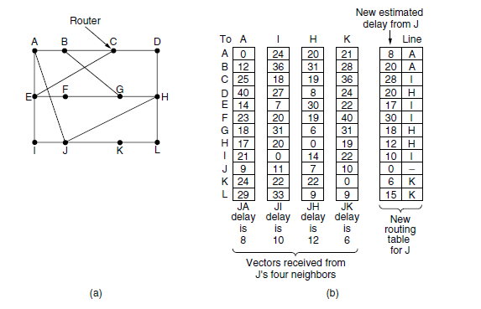
Distance Vector (Bellman-Ford) Algorithm
Adaptive; Distributed Routing
Each node is exchanging information with their neighbours
Information to be exchanged is the information about the entire network as captured by the specific neighbour node (Routing table)
Periodic updates; accordingly the routing tables are updated
Compute new route JG; JG = JA +AG/ JI+IG/ JH+HG/ JK+KG; 8+18/ 10+31/ 12+6/ 6+31; Minimum cost is 18, Next hop to reach G from J will be H.

Slide 8
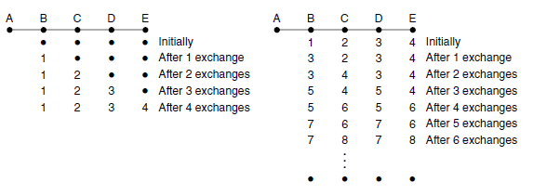
Count-to-Infinity Problem
Good news propagate within a network in a satisfactory way
Bad news are propagating slowly; which is not desirable

Slide 9
Link-State Routing
Adaptive; Distributed Routing
Each node is generating a packet that contains the local information i.e. Information about the neighbours
Each node floods the packet to all the nodes within the network
Each node have an accurate perception about the changed topology of the network; thus the decision will be more accurate compared to Distance Vector.
Demands huge bandwidth due to flooding
In general No Periodic updates; triggers whenever needed

Slide 10
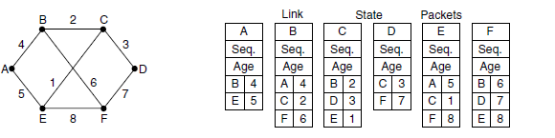
Link-State Routing
Sequence Number: used for distinguishing between fresh and stale Information ; e.g. A,1..(the Link State Packet generated by A with Sequence Number 1) is the old information compared to (A,2)
Age: Counter that ensures that a packet must exist a finite time within network; Chances of congestion will be reduced
:

Slide 11
Link-State Routing
Discover its neighbours and learn their network addresses.
Set the distance or cost metric to each of its neighbours.
Construct a packet telling all it has just learned.
Send this packet to and receive packets from all other routers.
Compute the shortest path to every other router.

Slide 12
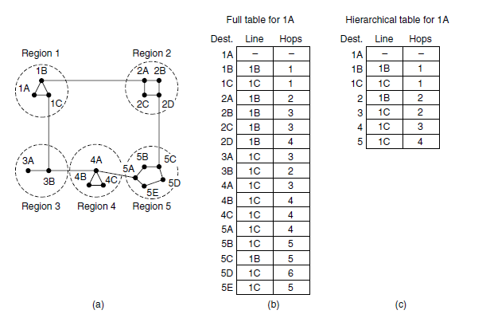
Hierarchical Routing
Routing table becomes large (more entries); More CPU time will be needed to scan them and for subsequent routing decision; chances of congestion will be more.......Solution : Hierarchical routing; No of entries are less
The best route from 1A to 5C is via region 2, but with hierarchical routing all traffic to region 5 goes via region 3, because that is better for most destinations in region 5.

Slide 13
Broadcast Routing: Sink Tree Broadcasting
A spanning tree is a subset of the network that includes all the routers but contains no loops. Sink trees are spanning trees. If each router knows which of its lines belong to the spanning tree, it can copy an incoming broadcast packet onto all the spanning tree lines except the one it arrived on. This method makes excellent use of bandwidth, generating the absolute minimum number of packets necessary to do the job.
Sink Tree knowledge is essential for each node.

Slide 14
Broadcast : Reverse Path Forwarding
When a broadcast packet arrives at a router, the router checks to see if the packet arrived on the link that is normally used (link within Sink Tree) for sending packets toward the source of the broadcast. (Unicast Routing table can be used for this purpose)
There is an excellent chance that the broadcast packet itself followed the best route from the router and is therefore the first copy to arrive at the router. This being the case, the router forwards copies of it onto all links except the one it arrived on. If, however, the broadcast packet arrived on a link other than the preferred one for reaching the source, the packet is discarded as a likely duplicate.

Slide 15
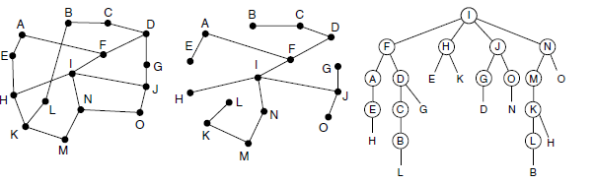
Broadcast Routing
Number of packet generation in Sink Tree = 14
Number of Packet generation in Reverse Path Forwarding = 24

Slide 16
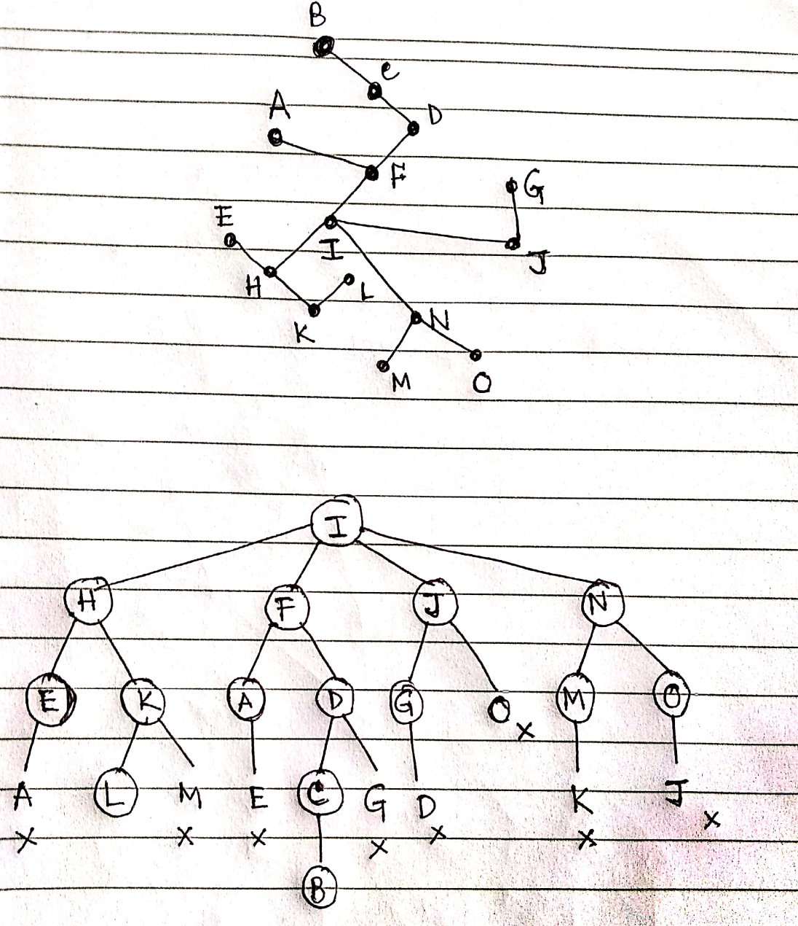

Slide 17
IP (Logical) Addressing
Identifier used to uniquely identify each device connected to the Internet
Two devices in Internet never have one IP at a time instant; but one device may have more than one IP addresses (Multi-homed devices) provided the device has two connections in the Internet via two networks
32 bit address expressed in dotted decimal format e.g. 241.132.40.19
Universal means all the nodes, interested to connect in Internet, must accept it

Slide 18
Classful IP Addressing
“class-full” addressing:
class
A
network
1.0.0.0 to
127.255.255.255
0
host
B
10
network
host
128.0.0.0 to
191.255.255.255
C
110
network
host
192.0.0.0 to
223.255.255.255
D
1110
multicast address
224.0.0.0 to
239.255.255.255
32 bits

Slide 19
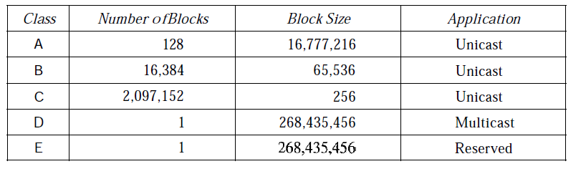
Classful Addressing

Slide 20
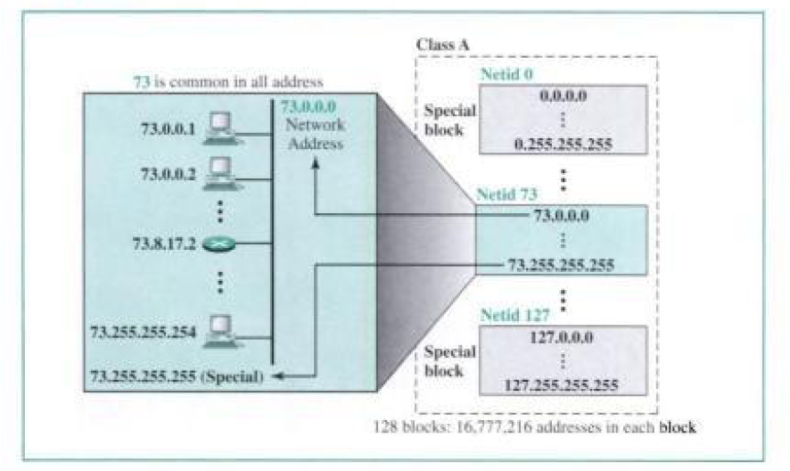
Classful Addressing

Slide 21
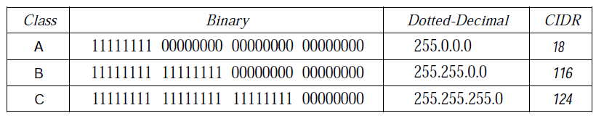
Masking
Masking is a process to find the netid from the given IP address.
For example, the mask for a class A address has eight 1s, which means the first 8 bits of any address in class A define the netid; the next 24 bits define the hostid.
Mask address of class A will be 11111111.0.0.0 and execute the bit by bit AND ing with the given IP; you will get the network address.

Slide 22
Classless Addressing
The no of devices on Internet are still less than 2³² but we have run out of class A and B add, class C block is too small for most midsize organizations.
If an organization was granted a large block in class A or B, it could divide the addresses into several contiguous groups and assign each group to smaller networks, called subnets.
The size of a class C block with a maximum number of 256 addresses did not satisfy the needs of most organizations. Even a midsize organization needed more addresses. One solution is to combine several class C blocks to create a largerrange of addresses, called supernetting.
Classless addressing addresses all the above said issues and provides a single solution.

Slide 23
Why Classless?
What about a small Business House that requires only 16 address or a household that needed only 2 addresses?
To overcome address depletion
Addresses are granted in blocks.
The size of the address block (the number of addresses) varies based on the nature and size of the entity.
The addresses in a block must be contiguous, one after another.
The number of addresses in a block must be a power of 2
The first address must be evenly divisible by the number of addresses.

Slide 24
Masking
A better way to define a block of addresses is to select any address in the block and the mask.
In IPv4 addressing, a block of addresses can be defined as x.y.z.t/n in which x.y.z.t defines one of the addresses and the In defines the mask.
A block of addresses is granted to a small organization. We know that one of the addresses is 205.16.37.39/28. What is the first address in the block? What is the last address?
Address: 11001101 00010000 00100101 00100111 [Class C]
Mask: 11111111 11111111 11111111 11110000
First add: 11001101 00010000 00100101 00100000 [205.16.37.32]
[32-28] 4 bits are there for addressing no of hosts within a network. Thus the number of host will be 2⁴ = 16. The last address within the block will be 205.16.37. 47

Slide 25
Subnet
An organization that is granted a large block of addresses may want to create clusters of networks (called subnets) and divide the addresses between the different subnets.
The rest of the world still sees the organization as one entity; however, internally there are several subnets.
All messages are sent to the router address that connects the organization to the rest of the Internet; the router routes the message to the appropriate subnets.
The organization, however, needs to create small subblocks of addresses, each assigned to specific subnets.
The organization has its own mask; each subnet must also have its own.

Slide 26
An Illustration of Subnetting
Suppose an organization is given the block 17.12.40.0/26, which contains 64 addresses. The organization has three offices and needs to divide the addresses into three subblocks of 32, 16, and 16 addresses.
Suppose the mask for the first subnet is n1, then 2^{32- n1} must be 32, which means that n1 =27.
Suppose the mask for the second subnet is n2, then 2^{32- n2} must be 16, whichmeans that n2 = 28.
Suppose the mask for the third subnet is n3, then 2^{32- n3} must be 16, which means that n3 =28.
This means that we have the masks 27, 28, 28 with the organization mask being 26.

Slide 27
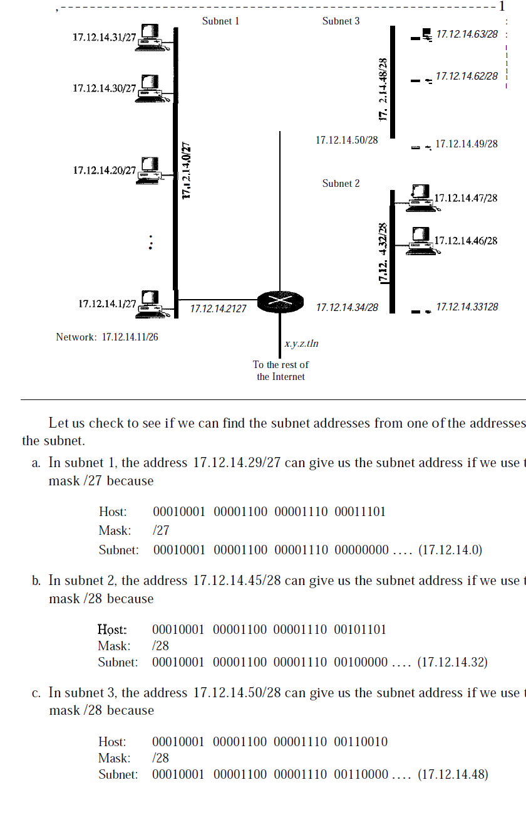

Slide 28
An Example
An ISP is granted a block of addresses starting with 190.100.0.0/16 (65,536 addresses). The ISP needs to distribute these addresses to three groups of customers as follows:
a. The first group has 64 customers; each needs 256 addresses.
b. The second group has 128 customers; each needs 128 addresses.
c. The third group has 128 customers; each needs 64 addresses.
Design the sub-blocks and find out how many addresses are still available after these allocations.

Slide 29
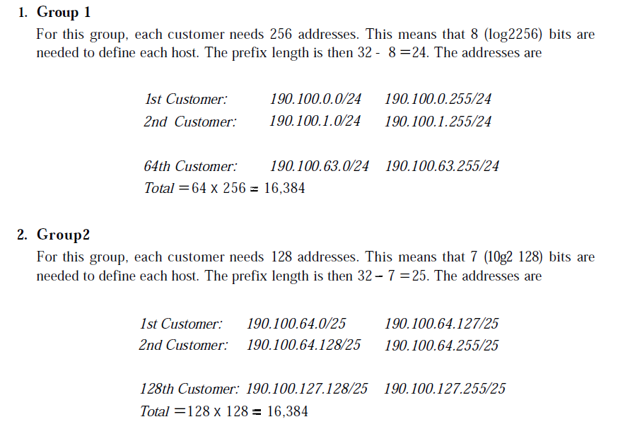
An Example

Slide 30
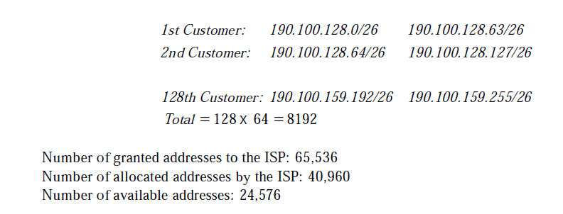
An Example

Slide 31
NAT
Consumers want to create small networks with several hosts and need an IP address for each host. With the shortage of addresses, this is a serious problem.
NAT (Network Address Translation) enables a user to have a large set of addresses internally and one address, or a small set of addresses, externally.
Private IP (e.g. 172.16.0.0 to 172.31.255.255) and Public IP concepts help to offer a solution.
The site must have only one single connection to the global Internet through a router that runs the NAT software. The private network is transparent to the rest of the Internet; the rest of the Internet sees only the NAT router

Slide 32
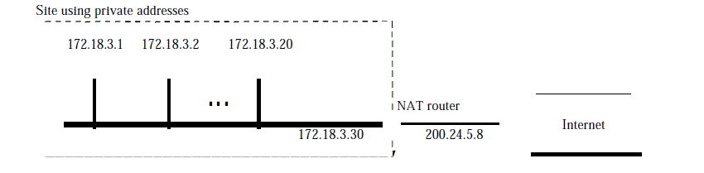
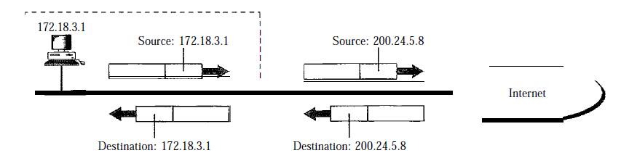
NAT

Slide 33
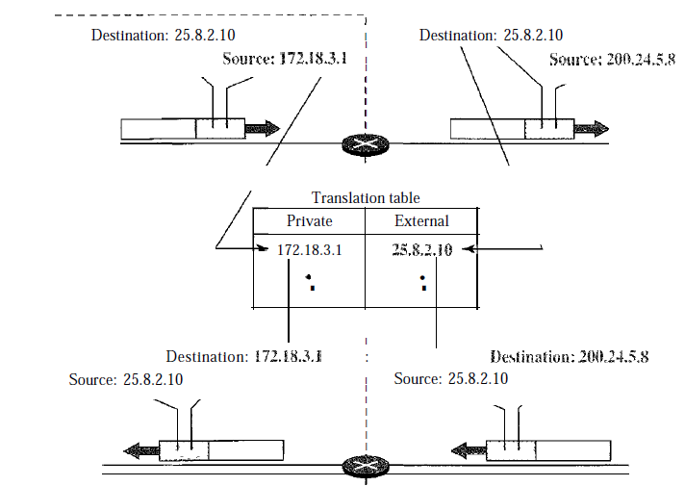
NAT
communication must always be initiated by the private network.

Slide 34
NAT
The NAT router may use a pool of global addresses.
For example, instead of using only one global address (200.24.5.8), the NAT router can use four addresses (200.24.5.8, 200.24.5.9, 200.24.5.10, and 200.24.5.11) i.e. Four private network hosts can communicate with the same external host at the same time because each pair of addresses defines a connection.
No private-network host can access two external server programs (e.g., HTTP and FTP) at the same time.

Slide 35
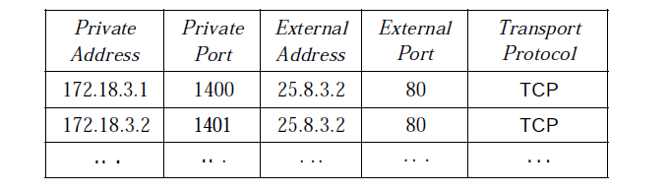
NAT
Suppose two hosts with addresses 172.18.3.1 and 172.18.3.2 inside a private network need to access the HTTP server on external host 25.8.3.2.

Slide 36
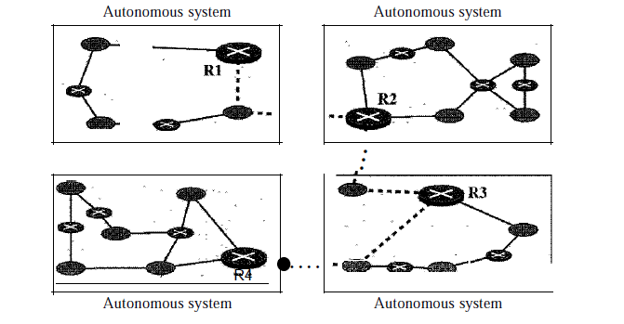
Intra & Inter Domain Routing
Internetwork is divided into smaller regions, called Autonomous Systems (AS, as suggested in Hierarchical Routing) for better scalability
Routing within an AS: Intra-domain Routing , Interior Routing e.g RIP/ OSPF
Routing between AS: Inter domain Routing, Exterior e.g BGP

Slide 37
Routing Information Protocol
Interior , Intra-AS routing; Working principle is Distance vector Routing (Bellman–Ford Routing)
In an AS, Only routers and networks (links) are considered. The routers have routing tables; networks do not.
The destination in a routing table is a network
The metric used by RIP is very simple; the distance is defined as the number of links (networks) to reach the destination. Thus the metric is hop count.
Infinity is defined as 16, which means that any route in an autonomous system using RIP cannot have more than 15 hops.
The next-node column defines the address of the router to which the packet is to be sent to reach its destination.

Slide 38
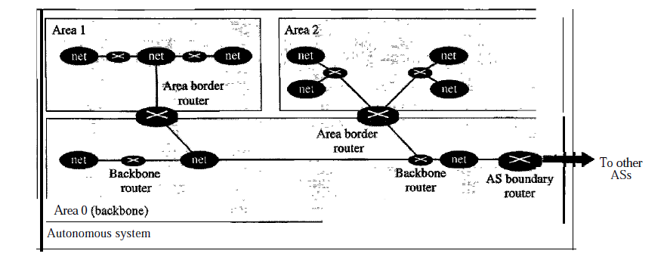
Open Shortest Path First - OSPF
Inerior/ Intra-AS routing; working Principle: Link-state Routing
Flooding becomes the key issue for offering a global view (of the network) to each node; Accuracy high than RIP
Bandwidth requirement is too high compared to RIP; As a result an Autonomous System is also divided into Areas

Slide 39

Link Classifications in OSPF
A point-to-point link connects two routers without any other host or router in between An example of this type of link is two routers connected by a telephone line. Graphically, the routers are represented by nodes, and the link is represented by a bidirectional edge connecting the nodes. The metrics, which are usually the same, are shown at the two ends

Slide 40
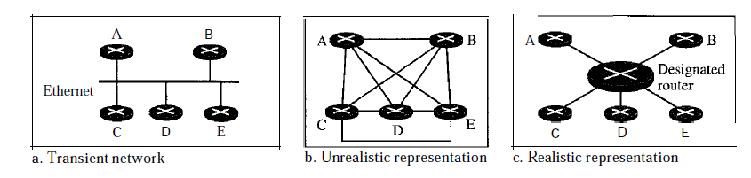
Transient Link
A transient link is a network with several routers attached to it. The data can enter through any of the routers and leave through any router. Each router has many neighbours.
Router A has routers B, C, D, and E as neighbours.
The representation in (b) is not efficient because each router needs to advertise the neighbourhood to four other routers, for a total of 20 advertisements
Each router is connected to every other router through one single network, the network itself is represented by a node (designated router); Thus the adv for neighbourhood estimation goes down to 10.

Slide 41
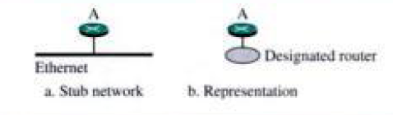
Stub and Virtual Link
A stub link is a network that is connected to only one router. The data packets enter the network through this single router and leave the network through this same router. This is a special case of the transient network.
When the link between two routers is broken, the administration may create a virtual link between them, using a longer path that probably goes through several routers.

Slide 42
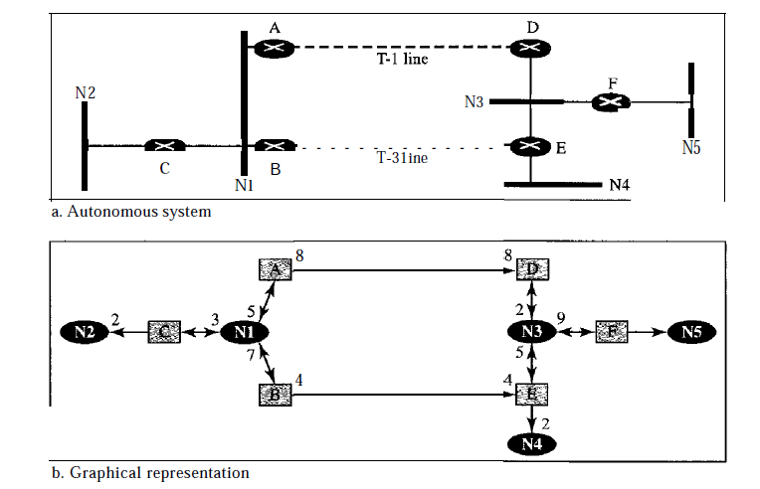
Graphical Representation of the Network

Slide 43
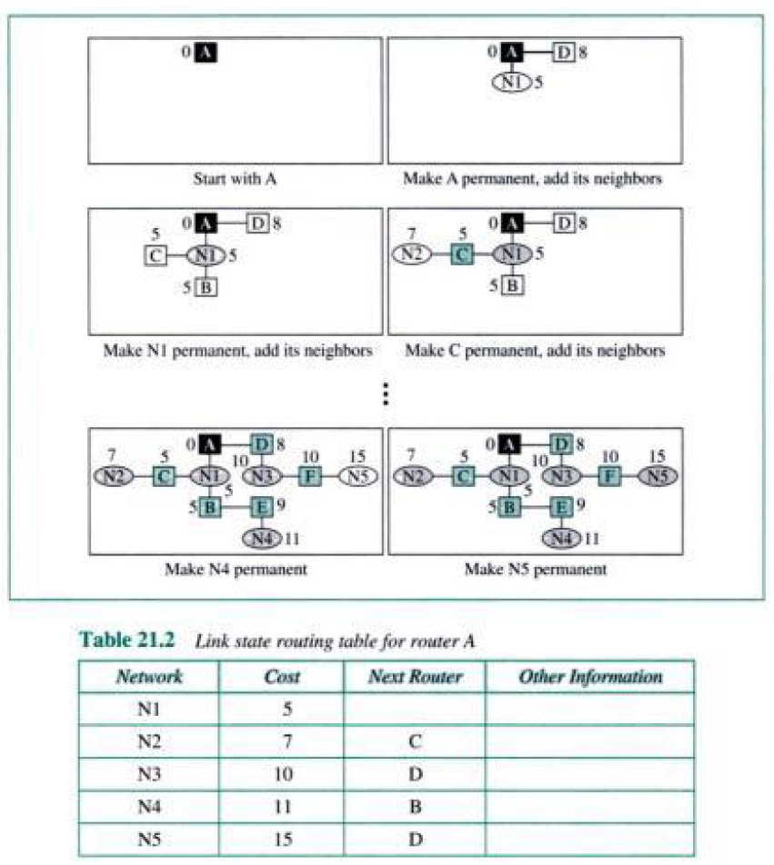
Shortest Path Routing

Slide 44
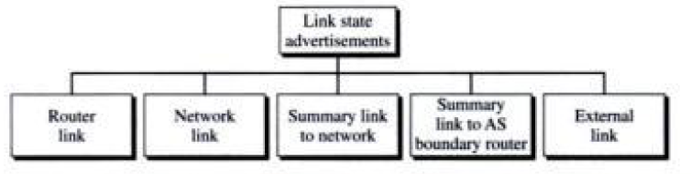
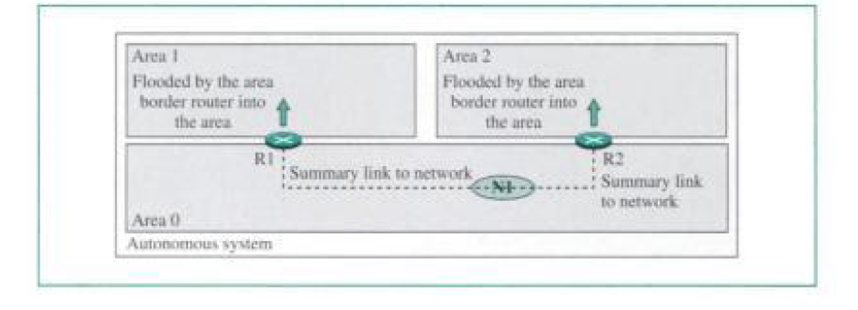
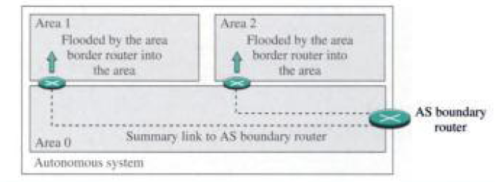
Link State Advertisement

Slide 45
Path Vector Routing
Inter AS routing
Distance Vector & Link State are not used for Inter AS routing
The principle of path vector routing is similar to that of distance vector routing.
Speaker node is a special node within each AS that acts on behalf of the entire autonomous system.
The speaker node in an AS creates a routing table and advertises it to speaker nodes in the neighbouring ASs.
A speaker node advertises the path, not the metric of the nodes.

Slide 46
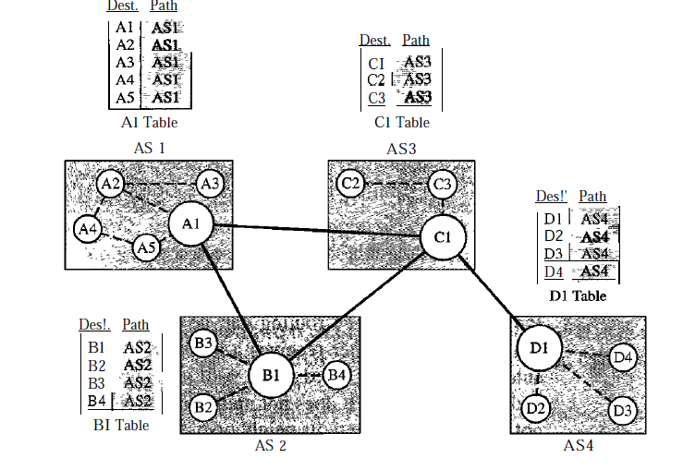
Path Vector Routing: Initialization

Slide 47
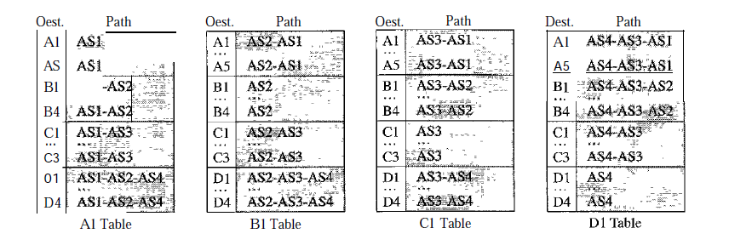
Path Vector Routing: Sharing
Policy Routing; Optimum Path? .....Loop Free

Slide 48
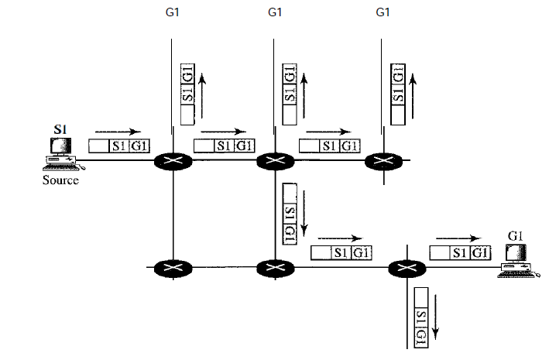
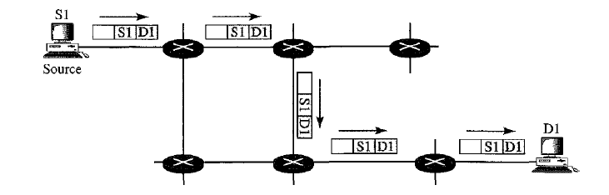
Unicast vs Multicast Routing

Slide 49
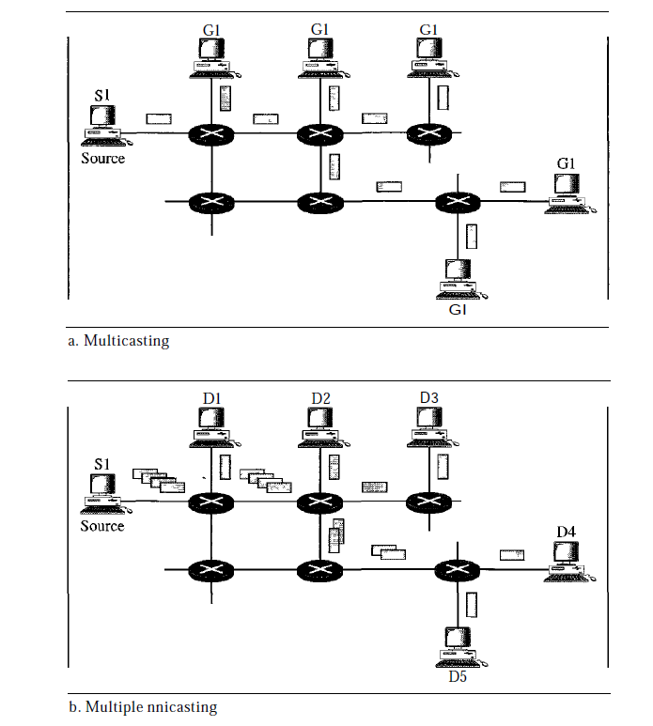
Multicasting vs. Multiple Unicasting
Multicasting requires less bandwidth than Multiple Unicasting
In Multiple Unicasting, Packets are created with a specific delay. Thus for a large no of pkts, the solution is not acceptable.

Slide 50
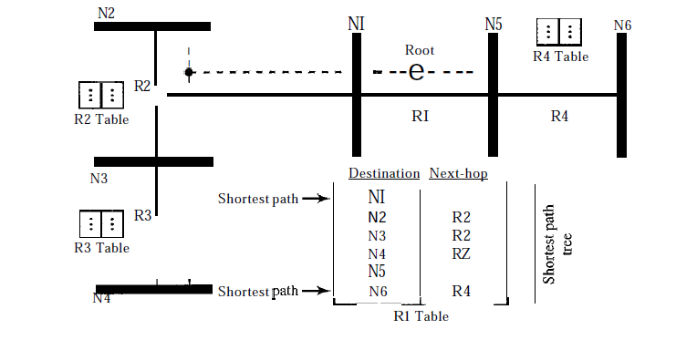
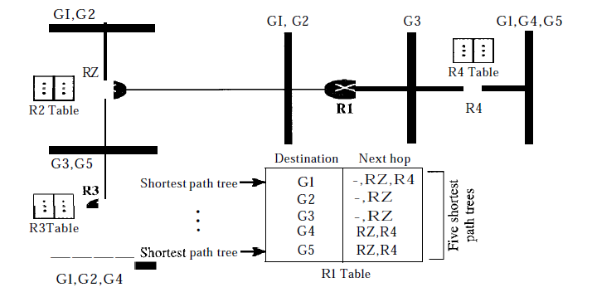
Source Based Tree Approach

Slide 51
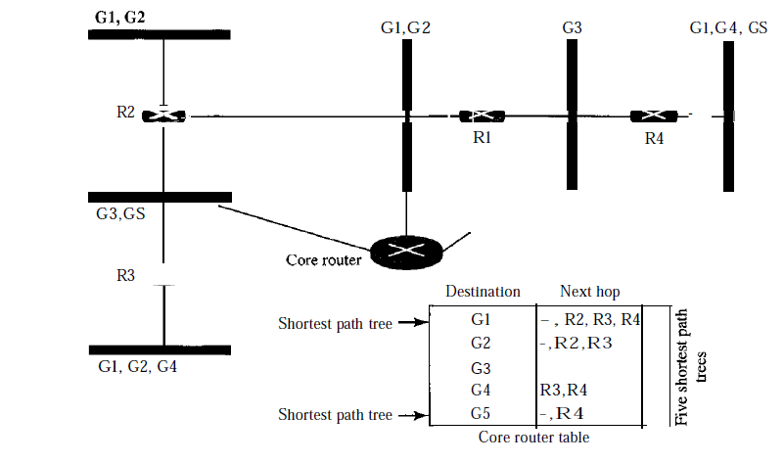
Group Shared Tree Approach

Slide 52
DVMRP
Multicast distance vector algorithm uses a process based on four decision-making strategies.
Flooding
Reverse Path Forwarding: RPF eliminates the loop in the flooding process. RPF guarantees that each network receives a copy of the multicast packet without formation of loops.
RPF does not guarantee that each network receives only one copy; a network may receive two or more copies.
The reason is that RPF is not based on the destination address (a group address); forwarding is based on the source address.

Slide 53
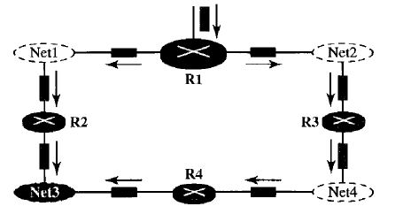
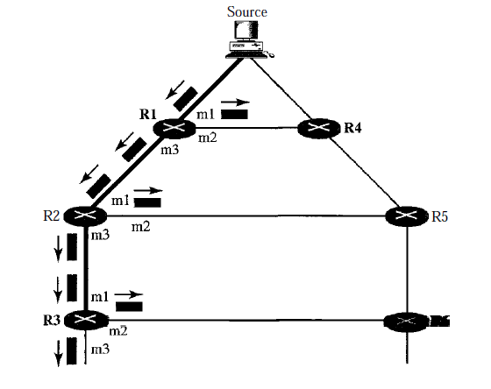
DVMRP

Slide 54
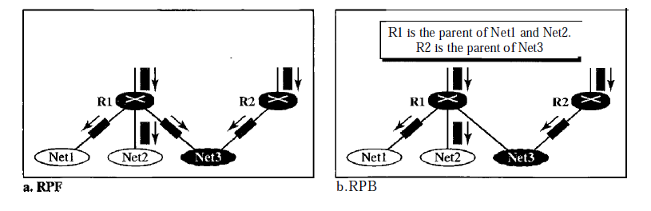
Reverse Path Broadcasting
Preventing duplication, only one parent router for each network is needed.
A network can receive a multicast packet from a particular source only through a designated parent router.
RPB guarantees that the packet reaches every network and that every network receives only one copy.

Slide 55
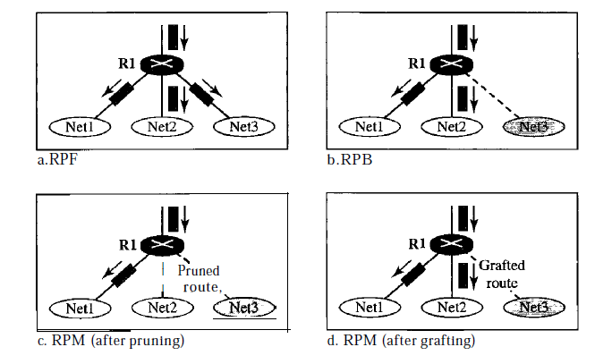
Reverse Path Multicasting

